Slide 1
System Development (COMP 1713)
Use Cases
Simon Scola
Alex Fedorec and examples from Arnon Rotem-Gal-Oz, arnon@rgoarchitects.com
Notes:
S.E.1
A.M.Fedorec

Slide 2
Summary so far…
Introduction to Systems Development
What is a system?
  The problems of software systems
  Over time and budget, don’t do what the user wants…
In software engineering we address problems by building models – it’s cheaper and quicker to identify problems and fix them in a model than to fix an implementation.

Slide 3
Use of Models
All engineers and architects including civil, mechanical and electrical build models of the system they are designing and implementing.
Modeling is an essential activity in software engineering.
Modeling aids understanding through visualization – see the parts and the relationships between them
Good modeling aids communication, avoids ambiguities and the need for assumptions

Slide 4
Modelling in the Development Process
Requirements elicitation and analysis
  Document and model current system
  Identify what we really need to build
Design and specify a solution
  Produce a plan or model of what we are going to build
  Check and refine the model (cheaper than checking and refining the implementation!)
Translate design (model) to implementation and Verify that what we build really does the job

Slide 5
Systems Building as a Process of Model Refinement
Analysis: High level abstract conceptual model identifying the basic concepts in the system
Design: Refine and add detail to produce a platform independent logical model
Specification: Refine into an implementation model by adding implementation specific information
Implementation: Translate the model
into a physical implementation (code)
Student
Course
Student
Name
DateOfBirth
Student
PK ID : Integer
Name : Char(100)
DateOfBirth : Date
    CREATE TABLE Student (
  ID INT NOT NULL PRIMARY KEY,
  Name NVARCHAR(100) NOT NULL,
  DOB DATETIME
  );

Slide 6
Modelling Continued
Discussion
When an architect models a building do they only model the physical structure?
No – they will model the dynamic forces on the building, the appearance of the building, the air circulation, the energy efficiency of the building… what else?
So far we have separated the information from the applications and only modelled the data and the data structures
Why? – discuss
When we model computer systems we also need to model their functionality.
What else might we want to model before committing ourselves to building a system (remember modelling is a lot cheaper and quicker than building)

Slide 7
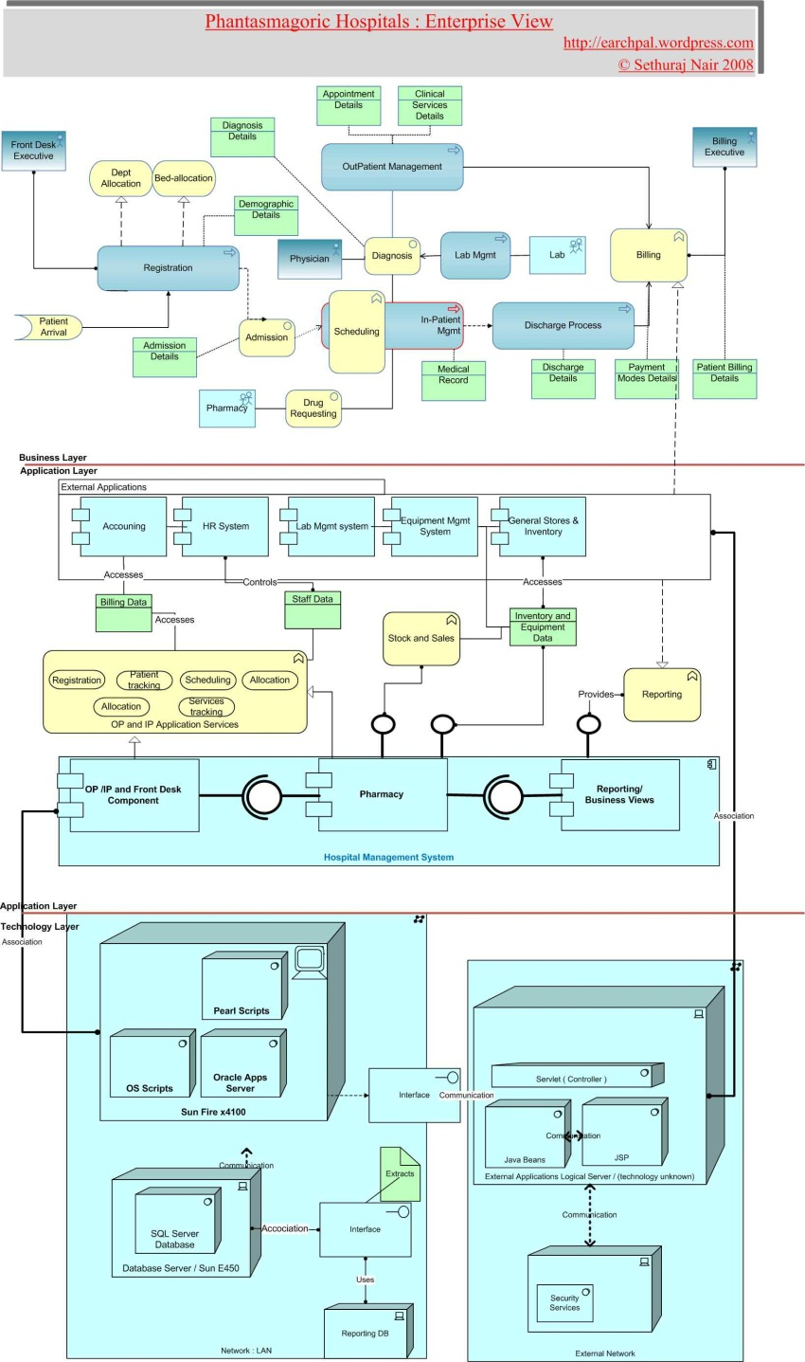
What other types of System Models might we need?
Discussion
Models of the functionality the system provides the end-users
Models of the system behaviour
– the processes – concurrency, interaction, synchronisation and communication
Models of the technical infrastructure, the physical components and the mapping of distributed software to hardware
Other types of model?
  Look and feel,
  Timing and performance models
  Development view and environment
  and so on…
Example architectural model of an IT system for a fictional hospital from
http://earchpal.wordpress.com/2008/08/03/archimate-its-time-has-come/
Notes:
S.E.1
A.M.Fedorec

Slide 8
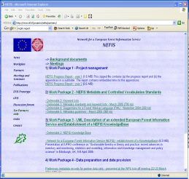
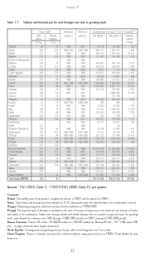

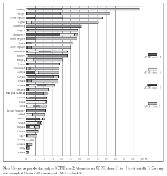


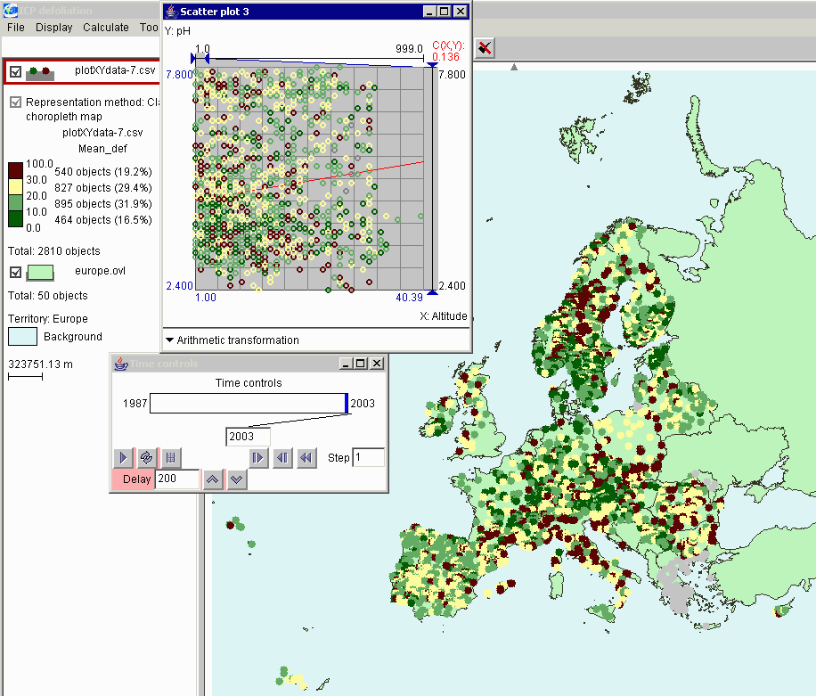

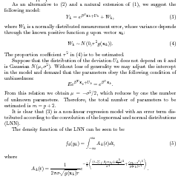

The Challenges of System Building – Where do we start?
Discussion
International/national
Gov. agencies, NGOs
Databases
Land use planners,
Mgrs, Sylviculturalists
Docs
The System
XLS
News media,
Public sector
Files
X
Commercial, financial,
Forest/timber industry
HTML
Consultants, Modellers,
Researchers, Education
Notes:
A.M.Fedorec OOP107APIClasses

Slide 9
Where do we start modelling – Data or functionality?
Methods Wars (1980s and 1990s)
Discussion – a bit of history
1980s saw a proliferation of structured Systems Analysis & Design methodologies and notations. Two main camps (there were many others):
    Functional Decomposition vs. Data Driven
    Build structured processes first Build upon the (structured) data
    Add data to code as required Build ad hoc queries
    Easier to sell/ talk to user Data more stable than functions
    Data structure not obvious (firmer foundation)
    Better for scientific users Processes on data in flux
    Better for control systems (processes are a moving target)
    Developed from previous Better for business users
    (Familiar) Needed databases
  Problems
  Each has strengths and weaknesses (neither guarantees loose coupling or high cohesion)
  Approaches did not integrate
  Use different methodology depending on what aspect of the system one is specifying
  Need to change technique as one moved from requirements elicitation to analysis to design and from design to programming

Slide 10
Where to Start Modelling – Cont’d
Discussion – a bit of history
  In the mid 1980’s various methodologies converged and a new approach emerged called the ‘Object-Oriented Paradigm’
  This unified the disparate system views with the concept of classes of objects which have their own identity, state and behaviour.
  O-O provides a smooth and traceable path from conceptual analysis to physical implementation and addresses the data-process divide
  A unified notation for describing the different views from an object-oriented perspective also emerged (“The Unified Modelling Language - UML”). This is now the de-facto standard language for describing and modelling systems.
Although object-orientation and UML provide the concepts and a standard notation for modelling and implementing all aspects of a system they do not provide a methodology for modelling.
A lot more on Object-Orientation and UML later…

Slide 11
Where to Start – Cont’d
Discussion – a bit of history
Some problems with last century analysis and design methodologies: prematurely partitioning the software, an over-emphasis on one aspect of software development: data engineering, run-time efficiency, or development strategy and team organization.
Greatest common single cause of failure was the architecture did not address the concerns of all its “customers” or “stakeholders”.
Good methodologies are now user-centric
The widest used technique is ‘Use-Case’ Analysis

Slide 12
Use Case Analysis
Contemporary software engineering is driven by identifying the users of a system (“actors”) and meeting their needs, expectations and requirements.
i.e. providing positive benefit to them (“Use Cases”).
vocabulary
functionality
system assembly
configuration mgt
Design View
Implementation
View
Use Case
View
behaviour
Process View
Deployment
View
performance
scalability
throughput
system topology
distribution
delivery
installation
logical physical
Kruchten, P.B., The 4+1 View Model of Architecture, IEEE Software, Nov 1995, pp. 42-50

Slide 13
What is a Use Case? - Definitions
Term comes from Ivar Jacobson:‘anvendningsfall’ which roughly means “situation of usage” or “usage case.” in Swedish.
Jacobson I., et al., Object-Oriented Software Engineering - A Use Case Driven Approach, Addison-Wesley, 1992.
“Use cases are a software modelling technique that helps developers to determine which features to implement and how to resolve errors gracefully.
“a use case is a description of steps or actions between a user (or "actor") and a software system which leads the user towards something useful.
Adolph, S., et al. Patterns for effective use cases. Addison-Wesley. 2002
“A use case captures a contract between the stakeholders of a system about its behaviour.
Cockburn,A., Writing Effective Use Cases, Addison-Wesley, 2010
Use Cases.<number>

Slide 14
What is a Use Case? Cont’d
Use cases are fundamentally a text form, although they can be written using flow charts, sequence charts, Petri nets or programming language
The text form normally lists:
  The use case name (and id number) and one line description
  The primary actor: the stakeholder who initiates and interaction with the system to achieve a goal
  Main success scenario (basic flow – “the Golden Path”)
    Basic flow of events of the use case when everything is perfect; there are no errors, no exceptions. This is the "happy day scenario".
  Extensions/Alternate Flows – what can happen differently during the scenario
Other things documented in a full Use Case:
  Stakeholders – someone with a vested interest in the behaviour of the system
  Pre-conditions and guarantees: what must be true before and after the use case runs
Most people start by identifying use cases with a ‘Use case diagram’
Use Cases.<number>

Slide 15
Example
  UC2 Get paid for car accident
  Primary Actor: Claimant
  Main Success Scenario:
  1. Claimant submits claim with substantiating data
  2 Insurance company verifies claimant owns valid policy
  3. Insurance company assigns agent to examine case
  4. Insurance company verifies all details are within policy guidelines
  5. Insurance company pays claimant and closes file
  Extensions:
  1a. Submitted data is incomplete
  1a1. Insurance company requests missing information
  1a2. Claimant supplies missing information
  2a. Claimant does not own valid policy
  2a1.Insurance company denies claim, notifies claimant, terminates proceedings.
Use Cases.<number>

Slide 16
Naïve approach to Use Case Modeling
Find Actors
Find Use Cases
Describe Use Cases
Use Cases.<number>

Slide 17
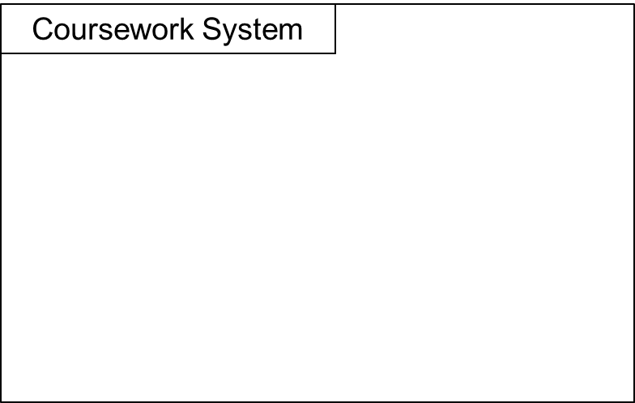
Use Case Diagrams
  It sometimes helps to start with a ‘Use case diagram’
  These identify the actors interacting with the system and their uses cases
Example: Imagine we are asked to design a system to support the electronic submission and marking of coursework
  Who are the actors?
  What are their use cases?
System Name
System Boundary
Notify work ready for marking
Upload coursework
Mark uploaded work
Download coursework spec
Student
Upload coursework spec
Lecturer
Check coursework mark
and feedback
Actor
Use Cases
UC Diagrams provide the 30,000 ft view of a system
Use Cases.<number>

Slide 18
UC Modeling Step 1: Define System Boundary
Vision and Scope
  What problems are solved
  Who are the stakeholders
  Client’s Organization main goals
  System main goals
  Boundaries of the solution
  Future Directions

Slide 19
System Boundary
Use cases define actor-specific system views
Requirements from the customer.
  Do not invent requirements
Defining the boundary can be tricky! (where do you draw the line?)
An iterative process
Systems Boundary: a box around the Use Cases
Online Shopping System

Slide 20
Use Case modelling process
Identify Actors
Identify Use Cases
  Identify through the Actors
  Consider each actor and decide which use cases this actor is supposed to perform
  For every complete course of events initiated by an actor identify one use case
  To identify the use cases read the req spec from an actor’s perspective and carry on discussions with those you will act as actors
  Ask questions such as:
    What are the main tasks of each actor?
    Will the actor have to read/write/change any of the system information?
    Will the actor have to inform the system about outside changes?
    Does the actor wish to be informed about unexpected changes?
  Write down name and a simple textual representation
Go to customer
Restart by refinement

Slide 21
Actor
Actor – Role(s) external parties that interact with the system
A kind of user of the system
Anything external to the system that interacts with it: Human, System
Represented diagrammatically as a Stick person
Online Shopping System
Payment
Verification
Service
Customer

Slide 22
Actors
Interact with and Benefit from the system
Outside the system
Model prospective users and other communicating systems
Define Roles, not instances
From them, Use cases can be identified
Identify the boundaries of the system
  Not always straightforward!
  Think of Keyboard or user

Slide 23
Primary Actors
Primary Actors
  What the system is being designed for
  Fulfils the user goals by using the services of the SuD (System Under Discussion).
  Eg: ‘Borrower’ in a Library System
Secondary Actors
  Provides a service to the SuD.
  Eg: Database administrator or 'Automated payment authorization service'.

Slide 24
Step 2: Finding the Actors
Identify
  Ask the End-Users
  Documentation
Issues
  Roles vs. Job Titles
  The Clock

Slide 25
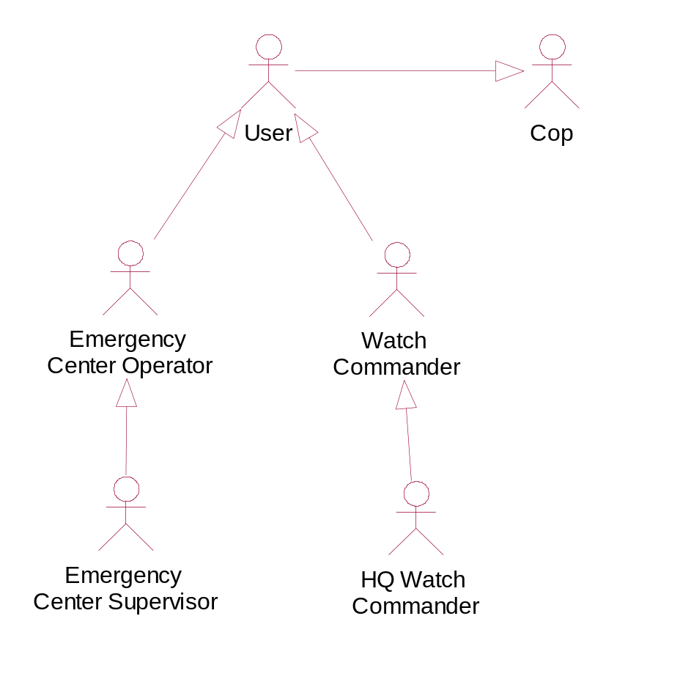
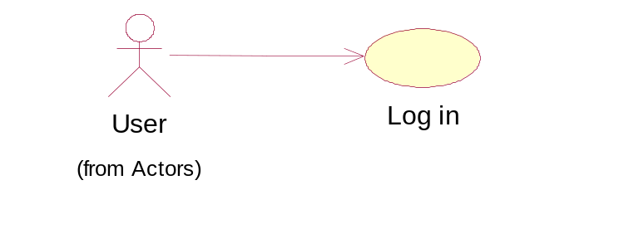
Actor Hierarchy
Big arrow indicates Generalisation/specialisation
Watch commander IS_A user, User IS_A Cop

Slide 26
Use Cases
Use Case – A sequence of actions that the system performs that yields an observable result of value to an actor. [Booch 1999]
Tasks or whole units of functionality that the system is required to support.
  Requirements view
One way (Case) of Use of the system
A typical interaction between a user and the system
Abstraction of various scenarios
Correspond to Events sequences between Actors and the system
An actor usually initiates them

Slide 27
Use Cases (contd)
Capture and communicate requirements
Capture some user-visible functionality
A Use Case achieves a discrete goal for an actor (beneficiary)
External model of the system
Start point for the dynamic model
Illustrate, but do not specify the behaviour of a system
UML diagrammatically represents them by an oval

Slide 28
Use Case Modelling in UML
“Use cases treat the system as a black box, and the interactions with the system, including system responses, are perceived as from outside the system. This is a deliberate policy, because it forces the author to focus on what the system must do, not how it is to be done, and avoids making assumptions about how the functionality will be accomplished.”

Slide 29
Step 3: Find Use Cases
Scenario Driven
  Find measurable value
  Business events
  Services actor needs / supplies
  Information needed
  Recurring
Actor/Responsibility
Unstructured aggregation
Mission decomposition
Misuse cases

Slide 30
Example: Finding Use Cases
What measurable value is needed by the actor?
  Plan Special Op.
  Monitor Special Op.
  Analyze Crime Patterns.
What business event might this actor initiate (based on her role)?
  Handle Emergency Call
  Call Car for Service
What services does the actor need from the system?
  Find Navigation Route
  Get Unit Status
  Map Incidents
What services does the actor provide?
  Dispatch Units
  Issue Tickets
What information does the actor need from the system?
  Get Car Registration History
  List Duties
What are the activities that are recurring and triggered by time?
  Get Updated Situation Awareness Map
  Generate Emergency Center Statistics Report
  Generate Crime Trends Report.

Slide 31
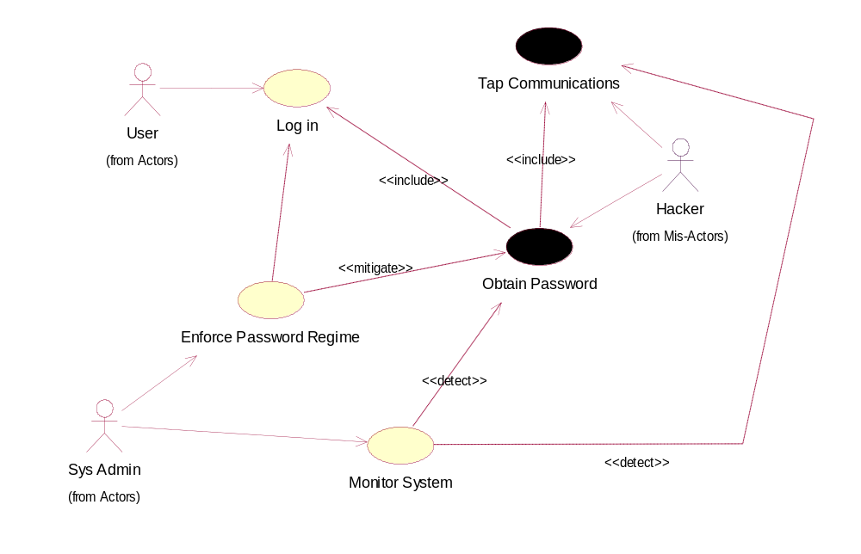
Example 2: Finding Mis-Use Cases

Slide 32
Find Use Cases ../2
Document Use Case:
  Initial Description
  Unique ID
  Scope
  Pre conditions
  Success Guarantee
  Trigger

Slide 33
Example : Initial description
Use Case: Run Special Op.
ID: UC4
Scope: The Watch Commander chooses a Special operation to manage. The task team chosen for the operation is briefed The watch commander then monitors the operation as it unfolds (sending out orders as needed) The task team is debriefed for the results and a final report is made.
Primary Actor: Watch Commander
Preconditions: A Special Op. Plan is saved in the system.
Success Guarantees: The Special Op. recordings (Forces movement, Voice recordings etc.) are saved in the system. The operation's statistics are saved in the system. Operation Final Report is saved and printed.
Trigger: The Watch Commander chooses a Special Op.

Slide 34
Step 4: Describe Use Cases
Template
  Main success Scenario
  Variations
  Exception
  Assumptions
  Status
  Priority
  Stakeholders and concerns
  Issues
  Non-behavioral reqs.
  Extension points.

Slide 35
Example : Use Case ../2
Main Success Scenario: The system begins recording the call. The system traces the caller address. The Operator takes the incidents location The system calculates available police units. The Operator takes the incidents detail The system presents a list of available teams and their distance from the incidents estimated location. The Operator chooses a unit to handle the incident The system dispatches the incident details to the chosen team. The Operator takes the caller details The system saves the incidents details including call statistics The system ends recording.
Variations: step 2 - when the caller uses a mobile phone Locate the callers current location step 2 - when the caller is on the black list (known to call for no reason) The Operator is presented with additional questions to ask the caller The system marks the incident as low-priority on count of possible false alarm. step 7 - when the incident does not require police intervention. The Operator closes the incident The system saves the termination reasons and continues from step 10 step 7 - if the incident requires a fire truck/ambulance The Operator chooses which authority to notify (fire / ambulance etc) The system dispatches the incident details to the appropriate authority's system
Use Cases.<number>

Slide 36

Example: Use Case ../3
Main Success Scenario: The system begins recording the call. The system traces the caller address. The Operator takes the incidents location The system calculates available police units. The Operator takes the incidents detail The system presents a list of available teams and their distance from the incidents estimated location. The Operator chooses a unit to handle the incident The system dispatches the incident details to the chosen team. The Operator takes the caller details The system saves the incidents details including call statistics The system ends recording.
Exceptions: step 2 - when the call cannot be traced The system suggests lowering the priority of the call on the count of an unknown caller The operator decides what priority to allocate for the incident. step 6 – when there is no available free force The system presents the operator with low-priority incidents (along with the reason for low-priority step 8 – communication problem with the unit dispatched The system performs step 6 and 7 again. step 8 – communication problem with all the units. The system presents the operator the incidents details to allow dispatching by radio/mobile phone.
Non Behavioral Requirements: The system should present as few screen as possible to the operator Locating a free unit should take less than 30seconds Communications to and from the unit should be secure (encrypted) to prevent eavesdropping by offenders/media
Use Cases.<number>

Slide 37
Reminder Example Use Case Diagram
System Name
System Boundary
Coursework System
Check Grades
Lecturer
Student
Upload Coursework
Use Cases
Actors

Slide 38
An example to do in class
A library keeps records of loans, books and members. It stores members’ names, addresses, status (junior or senior), loan limit (number of books a member may borrow) and date of birth; members are given individual member numbers when they join the library. The library also stores information about its books: title, authors, publishers, publication date, ISBN and purchase price. As some books are very popular, the library often buys several copies of the same book. All loans are for three weeks. The library needs to be able to record, edit and delete member details; record, edit and delete book details; record loans and returns, and reserve books. Overdue notices are to be sent when books are overdue. It also wants its library system to automatically update member status. The system must also record the current price of a book.

Slide 39
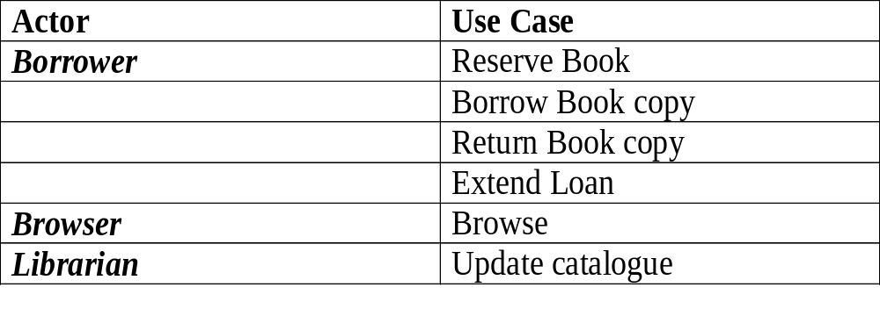
A Library system
Actors
Borrower
Browser
Librarian

Slide 40
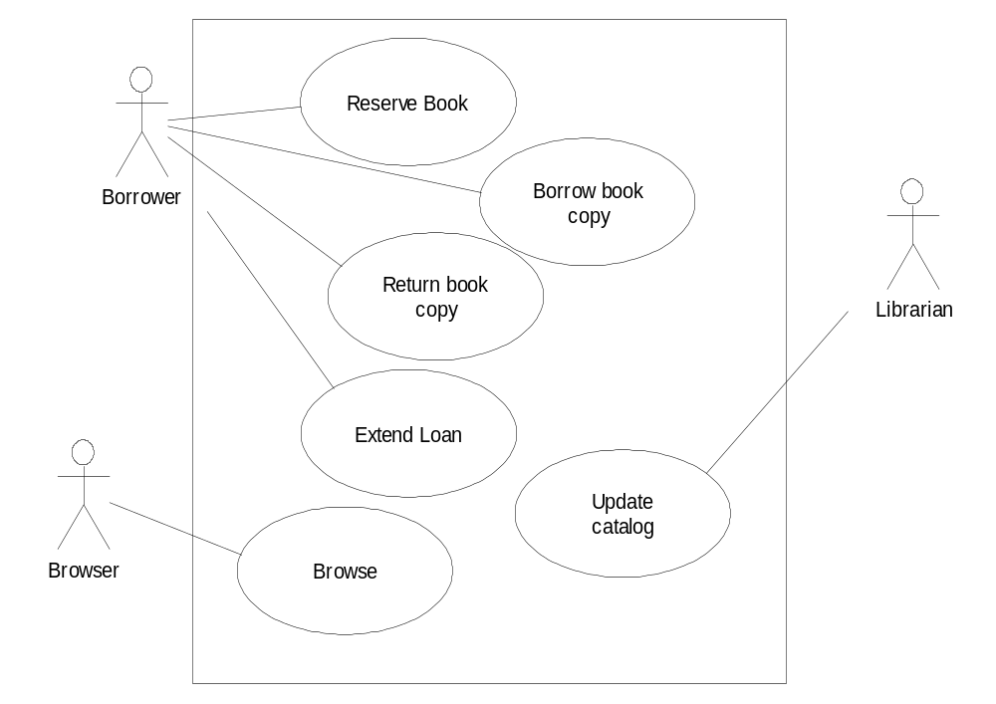
Use Case Diagram

Slide 41
Some points..
Actors here were all Roles
Librarian, inside or out?
Borrower is alone in reserving?
  Librarian
  Logical design
No non-human Actors

Slide 42
Links between use cases
<<include>>
  A use-case always includes another use-case
<<extend>>
  A use-case may extend to use another use case
Inheritance
  Specialisation and Generalisation
  Also there could be links between actors, such as inheritance
Motivation: Reuse

Slide 43
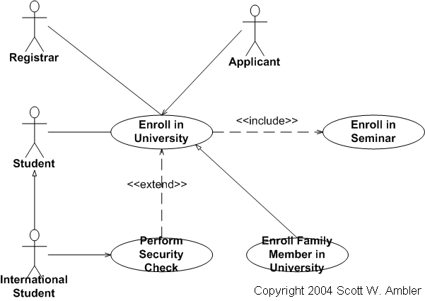
Example of links between use cases

Slide 44
Documenting Use cases
Documenting use cases
Each use case has to be described in a flow of events document.
This textual document defines what the system has to do when the actor activates a use case. The structure of a use case document can vary, but a typical description would contain
• Brief description
• Actors involved
• Preconditions necessary for the use case to start
• Detailed description of flow of events that includes:
Main flow of events that can be broken down to show: -
Sub flows of events
• Alternative flows to define exceptional situations
• Post conditions that define the state of the system after the use case ends

Slide 45
Documenting Use cases
Use case
Brief Description
Actors
Precondition
Main flow
Alternative flow
Post condition

